Slide 1

Innovative computing paradigms – quantum computers
Presented by: Vesela Krumova
Faculty number: 201220014
Group: 87

Slide 2

Meaning of Quantum computing
How does Quantum computer work?
Quantum computing
Interesting information
Various applications
Advantages and disadvantages

Slide 3
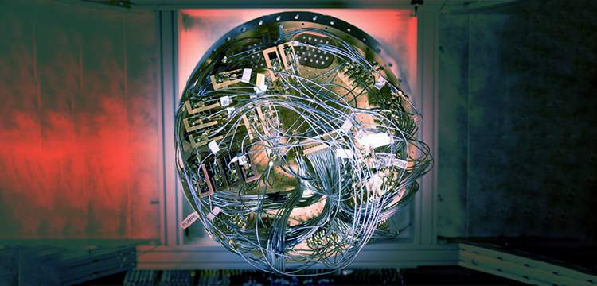

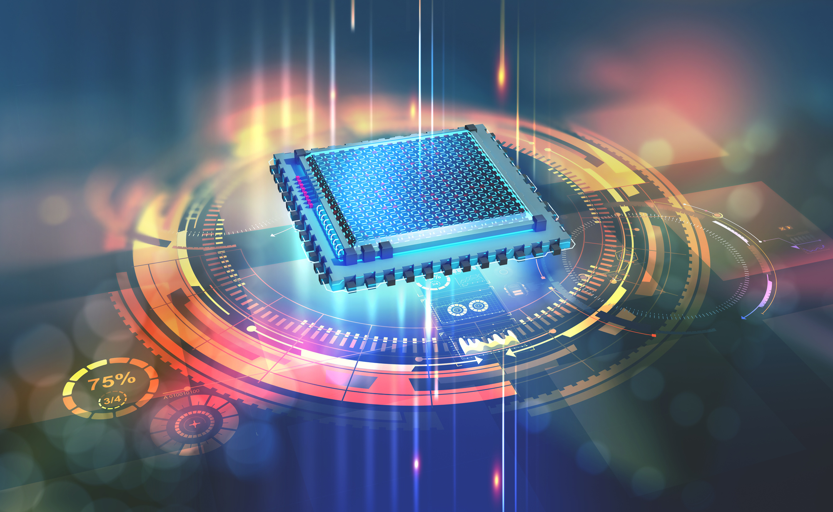
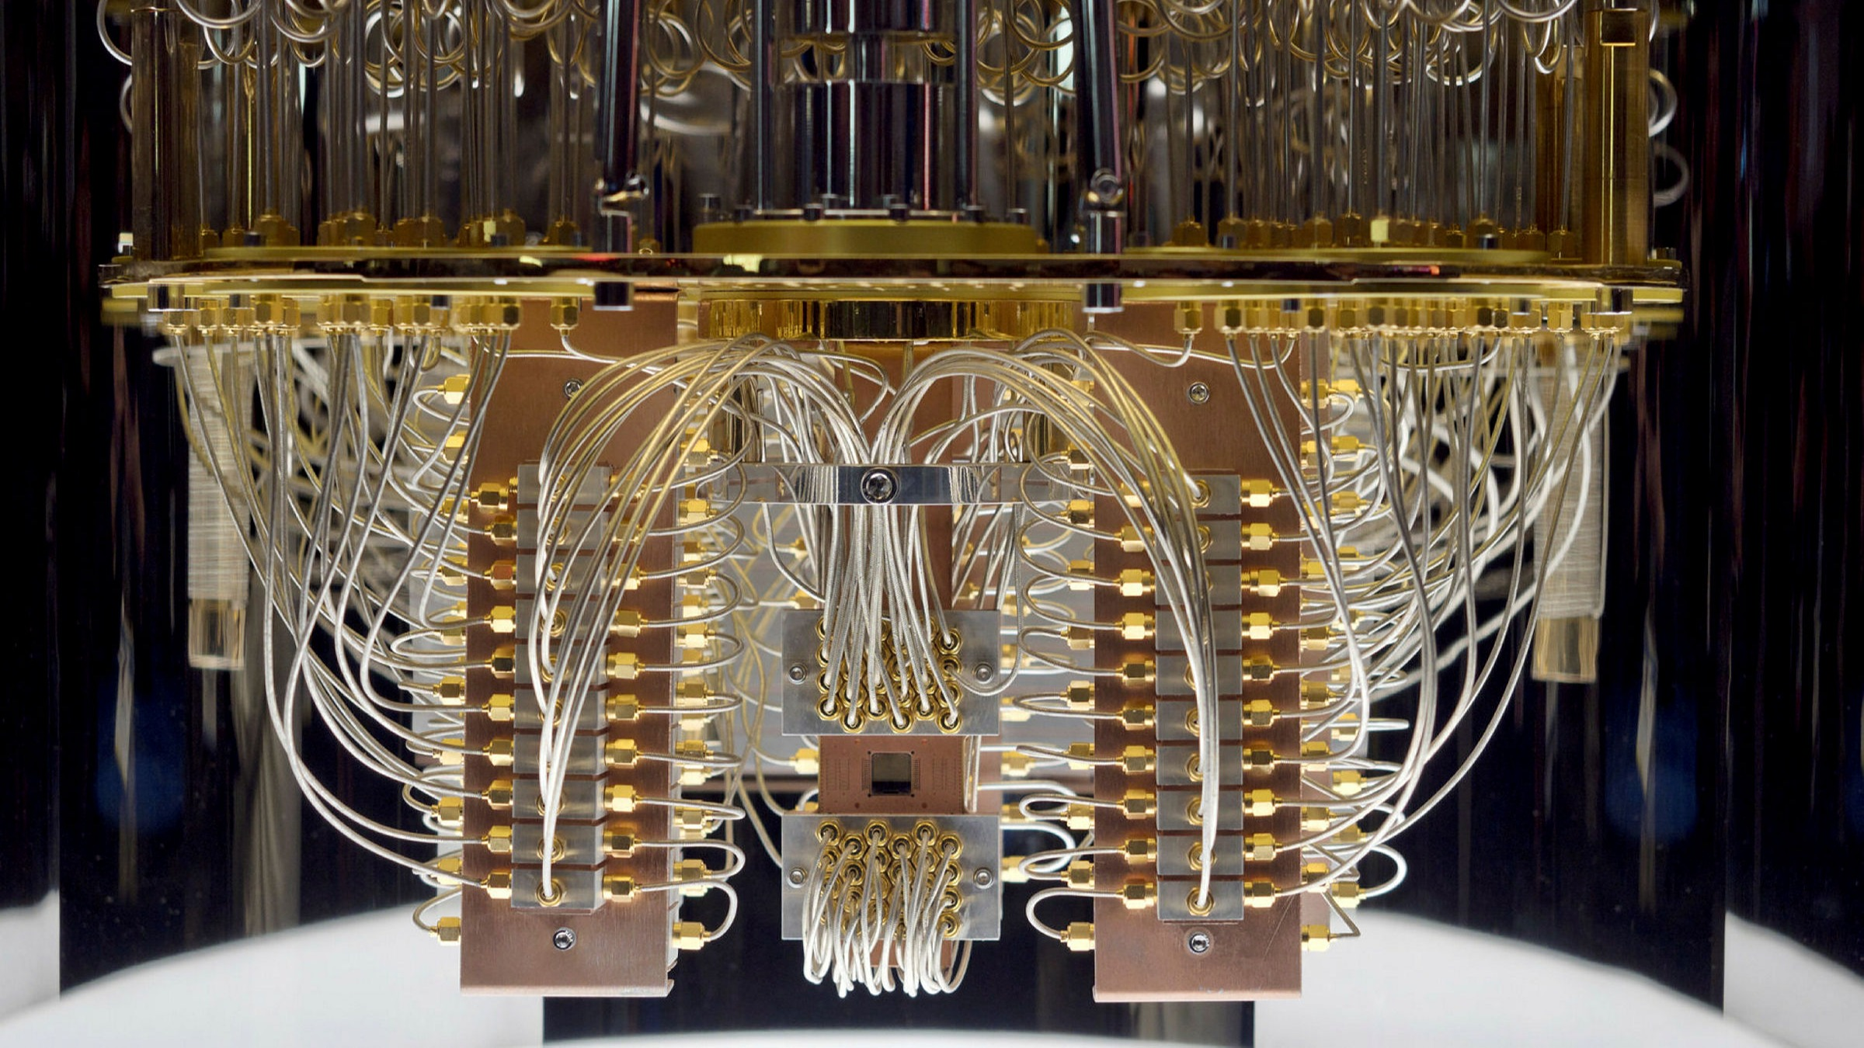


Meaning of Quantum computing
process of computing using the concept of quantum mechanics;
the first quantum computer (2-qubit);
based on the theory that explains the behavior of energy at atomic or subatomic levels;
related to the “Quantum supremacy”;

Slide 4



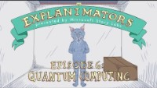
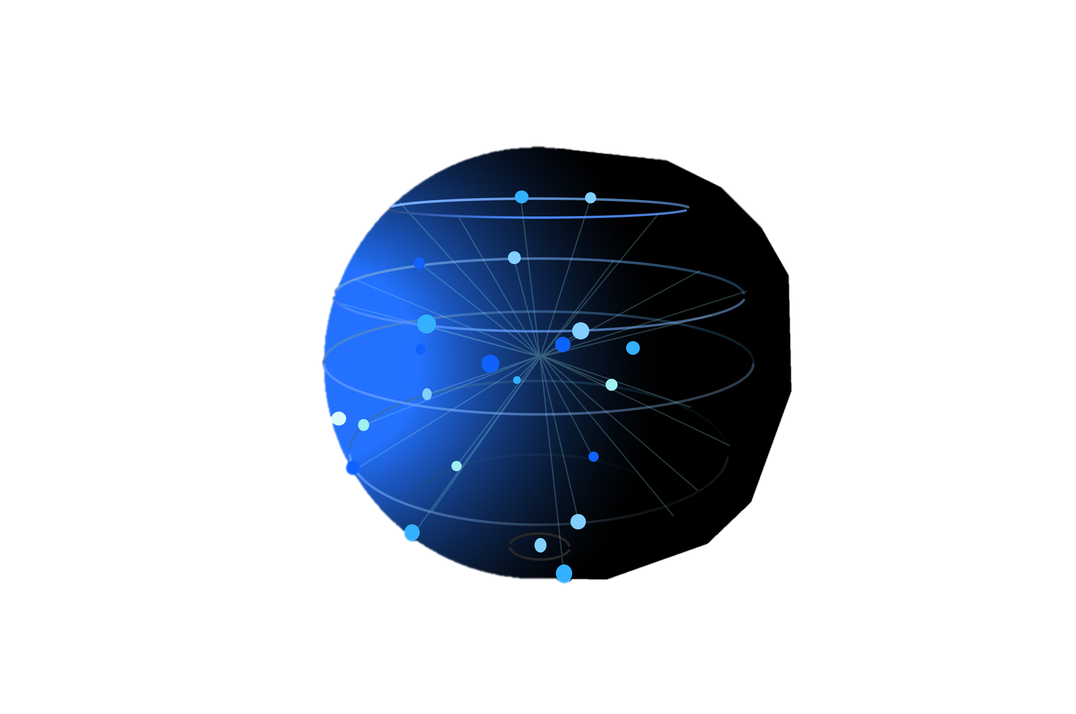
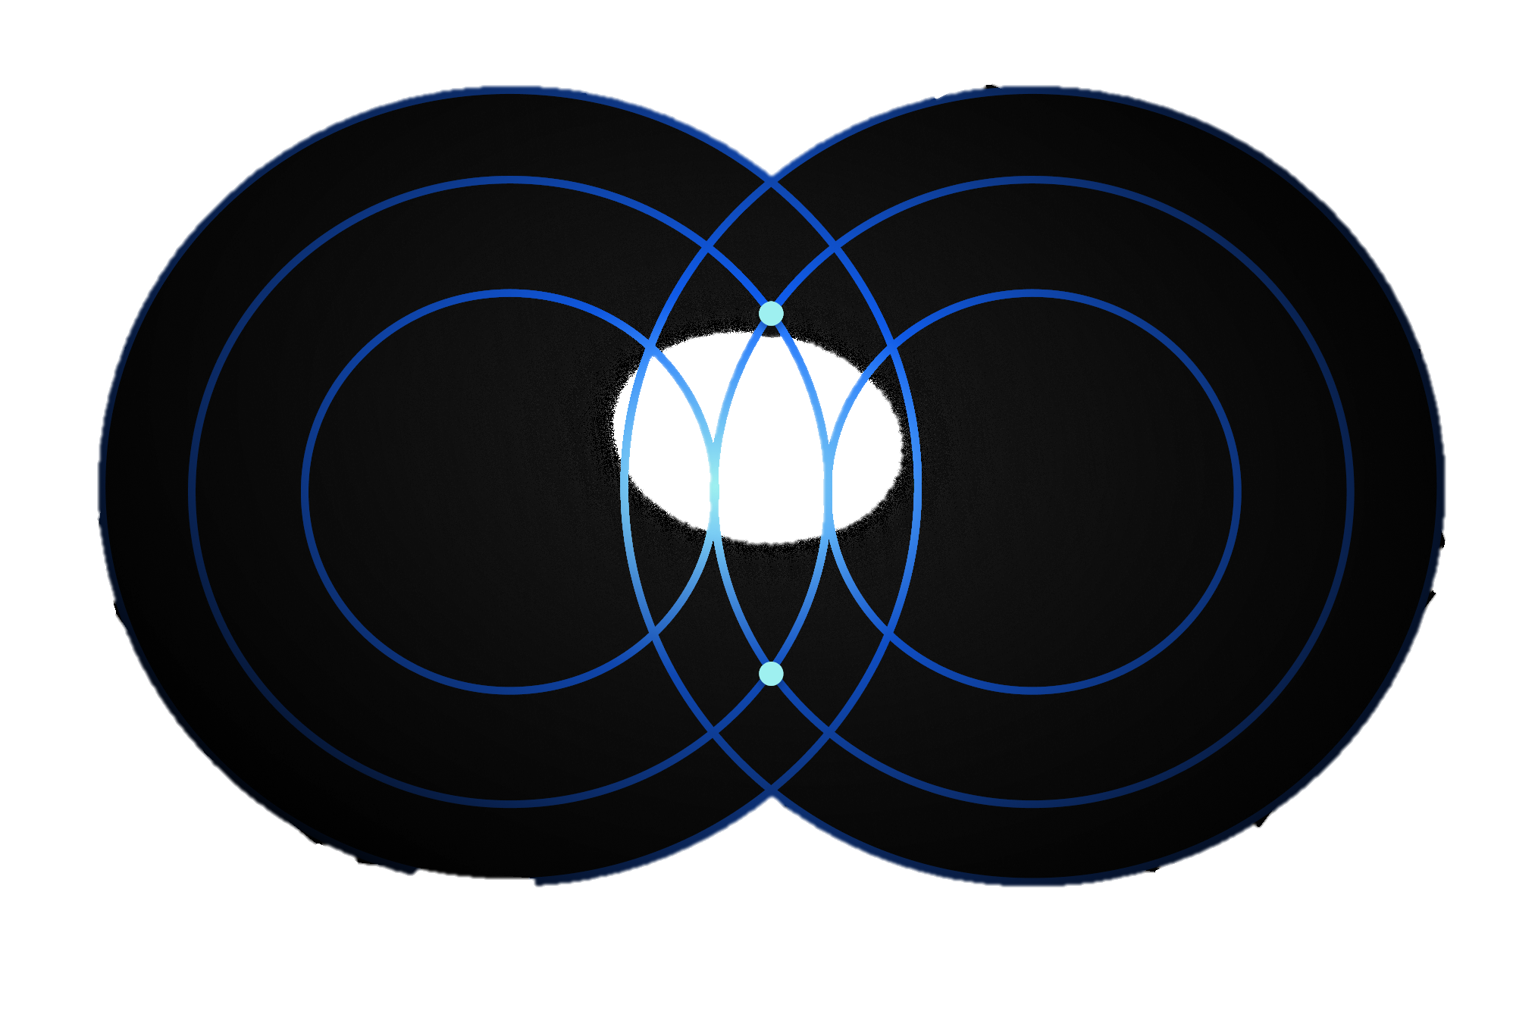


How does Quantum computer work?
quantum computers transmit information via quantum bits, or qubits;
the difference between the quantum computer and classical computer;
the meaning of superposition and entanglement;
the intentions of Google - one of the main domain in the computing;
Superposition
Entanglement
Quantum computing is essential for quantum informatics

Slide 5

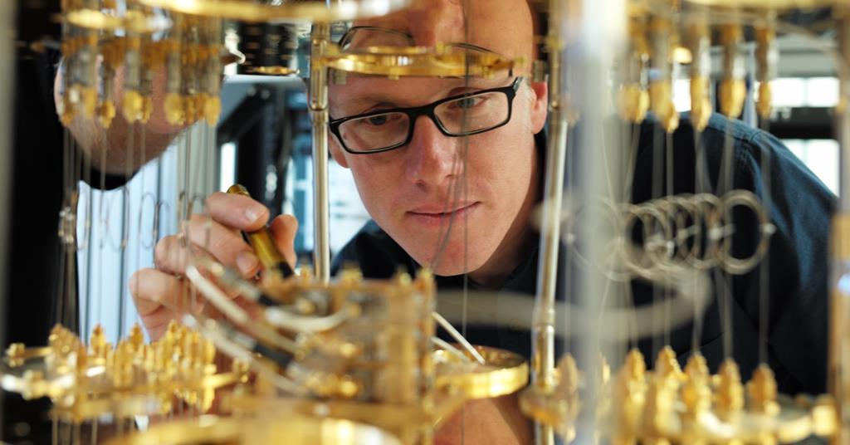

Interesting information
the most important thing to know about a quantum computer;
the essence of the work of a quantum computer;
some interesting implications;
designs for a universal quantum computer;

Slide 6

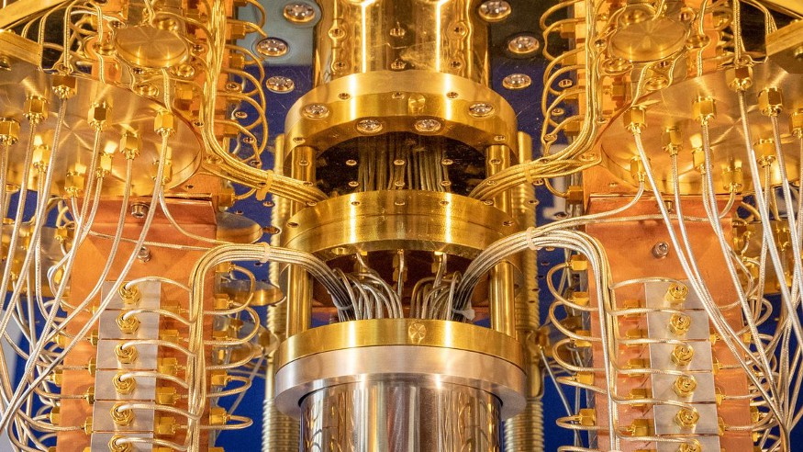

Superconducting loops
the most popular technology;
powered by a superconducting qubit-based processor;
this technology requires extreme isolation from the environment;
quantum processor itself occupy small part of these refrigerators;

Slide 7
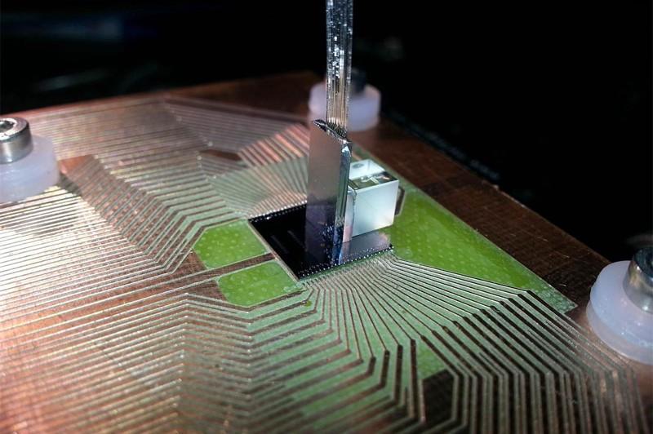
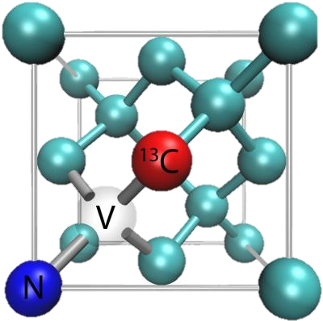
Diamond vacancies
a perfectly pure diamond crystal contains nothing but carbon atoms;
the idea of creating of a diamond crystal evolved from the research on biomolecule detection;

Slide 8

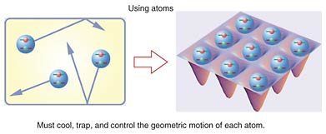
Neutral atom qubits
the use of lasers and magnets to cool single particles to a temperature of nearly absolute zero;
the machine is powered by a set of atoms (generally rubidium);
atoms are naturally identical, so are the qubits made with them;

Slide 9
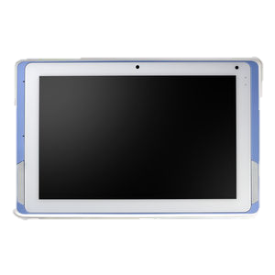
Various applications`
Artificial Intelligence
Molecular Modeling
Cryptography
Financial Modeling
Weather Forecasting
Particle Physics

Slide 10

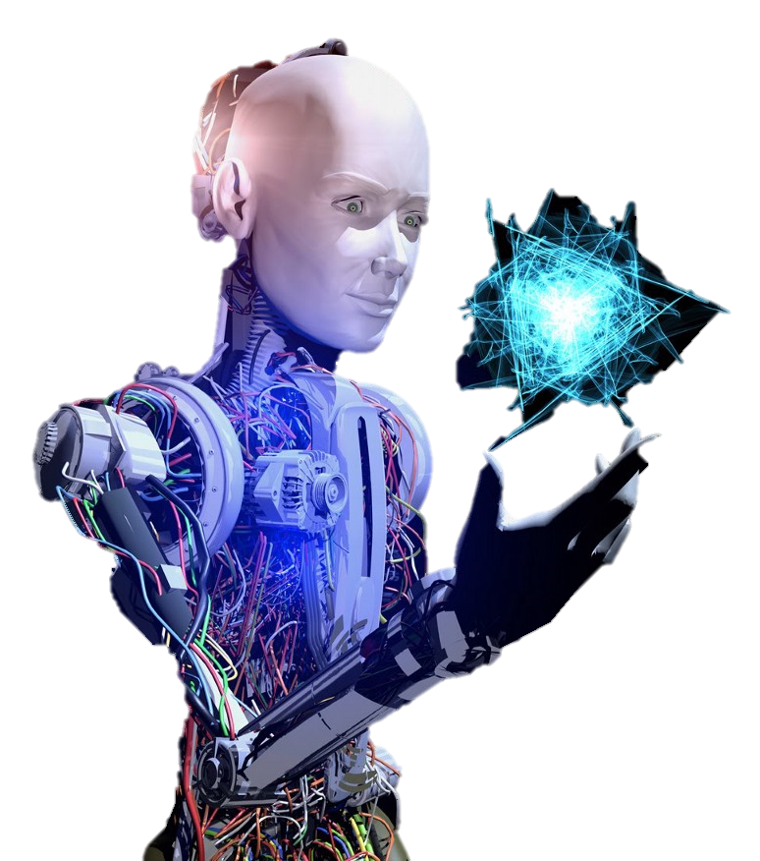


Artificial intelligence
based on the principle of learning from experience;
becoming more accurate as feedback is given;

Slide 11

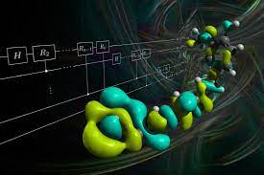

Molecular modeling
finding the optimum configurations for chemical reactions;
chemical reactions are quantum in nature as they form highly entangled quantum superposition states;

Slide 12



Cryptography
online security depends on the difficulty of factoring large numbers into primes;
creating encryption methods - quantum cryptography;

Slide 13

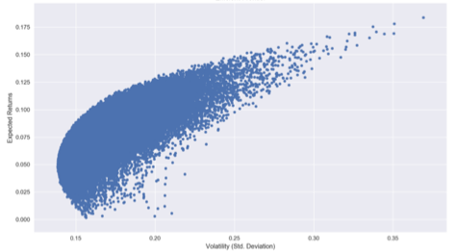
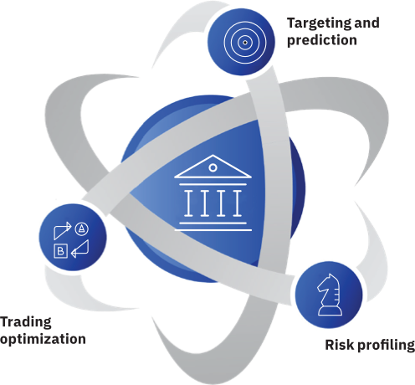

Financial modeling
modern markets - some of the most complicated systems in existence;
quantum computers correspond to the nature of financial markets;

Slide 14


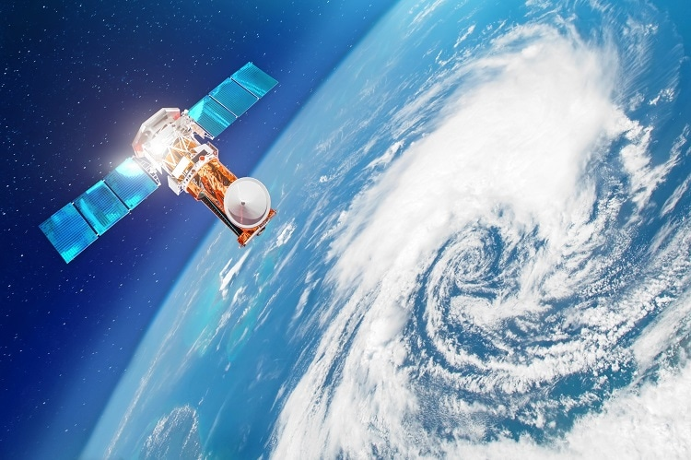
Weather forecasting
building better climate models;
determine what steps need to be taken now to prevent disasters;

Slide 15

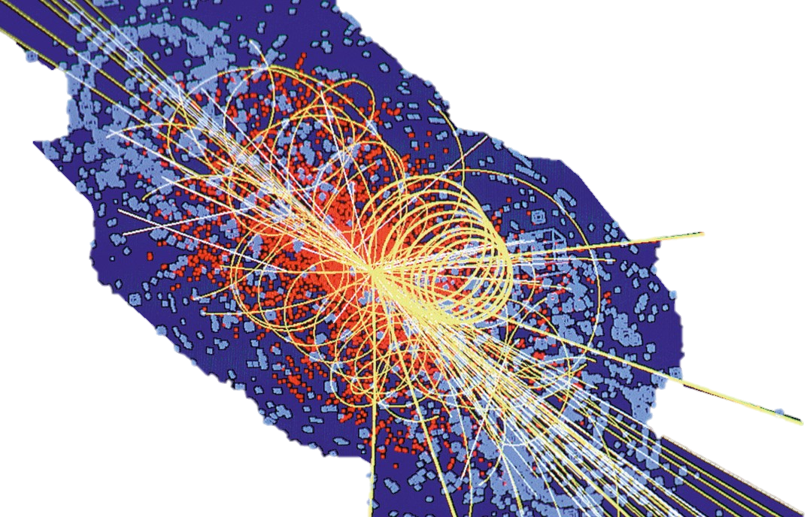
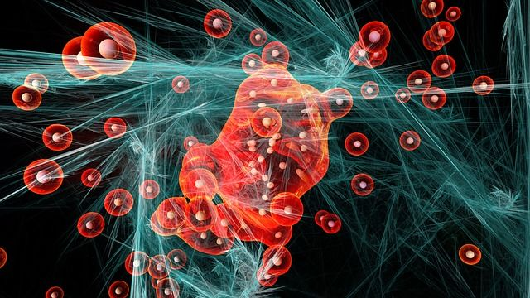
Particle physics
often extraordinarily complex;
big amounts of computing time for numerical simulation;

Slide 16

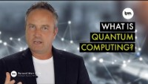
Advantages and disadvantages
Faster computations
Best for simulation
Algorithm creation
Low temperature
Advantages
Disadvantages
Google search
Medicine creation
Not open for public
Internet security

Slide 17
Sources
https://www.analyticssteps.com/blogs/what-quantum-computing-working-requirement;
https://bitmesra.ac.in/naps/quantum-computing/;
https://builtin.com/hardware/quantum-computing;
https://www.zdnet.com/article/what-is-quantum-computing-understanding-the-how-why-and-when-of-quantum-computers/;
https://medium.com/swlh/7-designs-for-a-universal-quantum-computer-d918e556d149;
https://singularityhub.com/2017/06/25/6-things-quantum-computers-will-be-incredibly-useful-for/;

Slide 18
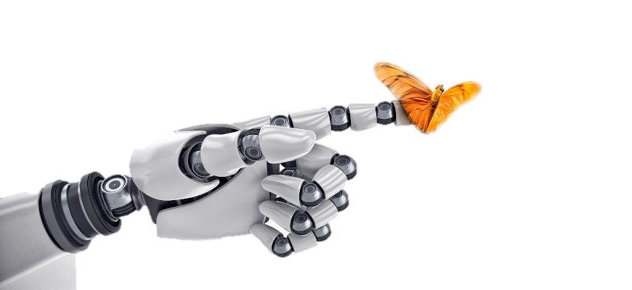
Thank you for your attention!

